Slide 1


CSE 405: Machine Learning
Parametric Methods
Dr Muhammad Abul Hasan
Department of Computer Science and Engineering Green University of Bangladesh muhammad.hasan@cse.green.edu.bd
Fall 2023

Slide 2
Parametric Estimation
Bayes’ Estimator
Parametric Classification
Parametric Regression
Bias/Variance Dilemma
Parametric Regression
Outline
Parametric Estimation
Bayes’ Estimator
Parametric Classification
Parametric Regression
Bias/Variance Dilemma
Parametric Regression
CSE 405: Machine Learning

Slide 3
“Colin– Powell
There are no secrets to success. It is the result of preparation, hard work,
and learning from failure.
”

Slide 4
Parametric Estimation
Bayes’ Estimator
Parametric Classification
Parametric Regression
Bias/Variance Dilemma
Parametric Regression
Parametric Estimation
CSE 405: Machine Learning

Slide 5
Parametric Estimation
Bayes’ Estimator
Parametric Classification
Parametric Regression
Bias/Variance Dilemma
Parametric Regression
Parametric Estimation
Parametric estimation refers to a class of methods in statistics and machine learning used to estimate the parameters of a known probability distribution or model from a given dataset.
X = {x^{t}}_{t} where x^{t} ∼ p(x)
Parametric estimation: Assume a form for p(x∣q) and estimate q, its sufficient statistics, using X e.g., N (µ, σ²) where q = {µ, σ²}
CSE 405: Machine Learning

Slide 6
Parametric Models: A parametric model assumes that the underlying distribution of the data can be described using a finite set of parameters.
Common examples include:
Normal distribution with parameters: mean 𝜇, and variance 𝜎²
Binomial distribution with parameters: number of trials 𝑛 and success probability 𝑝
Poisson distribution with parameter: rate 𝜆

Slide 7
Parameters: The parameters are the quantities that define the shape or behavior of the distribution.
For example, the mean and variance in a normal distribution determine its location and spread. The goal of parametric estimation is to use the observed data to infer the most likely values for these parameters.
Estimation Methods: There are several methods for parametric estimation, with two of the most widely used being Maximum Likelihood Estimation (MLE) and Method of Moments.

Slide 8
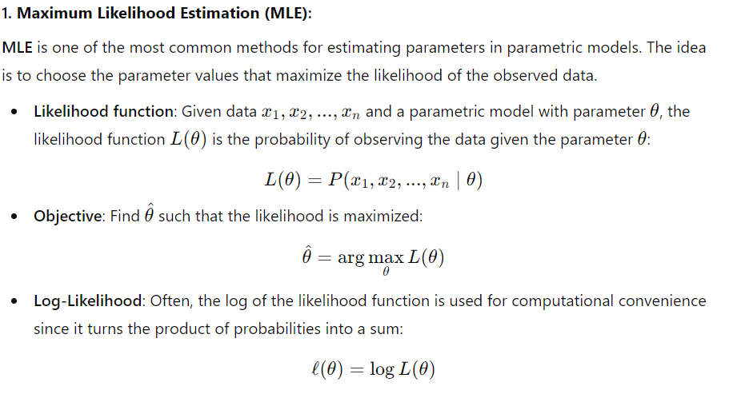
Parametric Estimation
Bayes’ Estimator
Parametric Classification
Parametric Regression
Bias/Variance Dilemma
Parametric Regression
CSE 405: Machine Learning

Slide 9
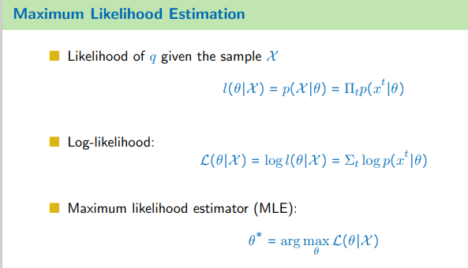
Parametric Estimation
Bayes’ Estimator
Parametric Classification
Parametric Regression
Bias/Variance Dilemma
Parametric Regression
∗
θ = arg max L(
θ∣X )
θ
CSE 405: Machine Learning

Slide 10
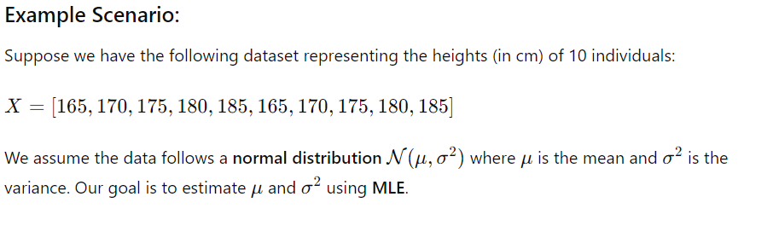
Parametric Estimation
Bayes’ Estimator
Parametric Classification
Parametric Regression
Bias/Variance Dilemma
Parametric Regression
CSE 405: Machine Learning

Slide 11
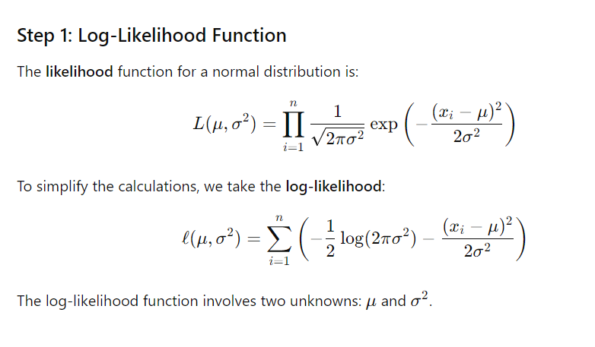
Parametric Estimation
Bayes’ Estimator
Parametric Classification
Parametric Regression
Bias/Variance Dilemma
Parametric Regression
CSE 405: Machine Learning

Slide 12
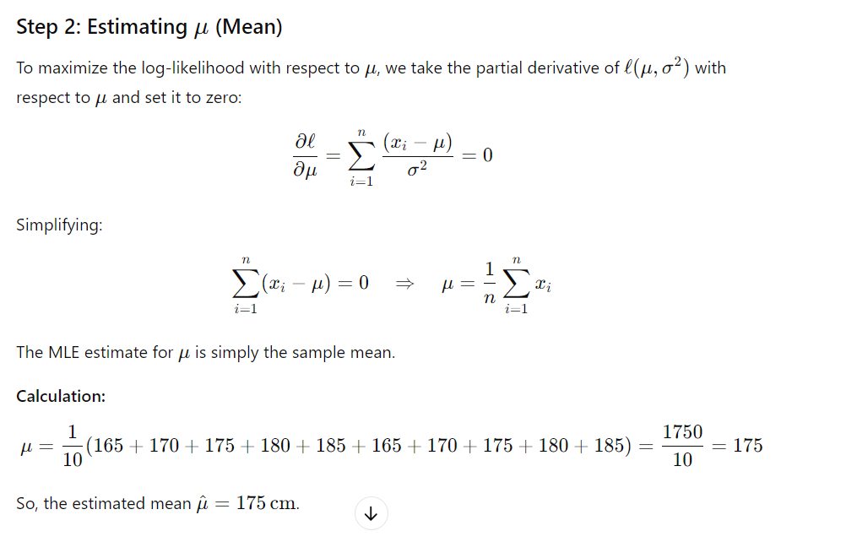
Parametric Estimation
Bayes’ Estimator
Parametric Classification
Parametric Regression
Bias/Variance Dilemma
Parametric Regression
CSE 405: Machine Learning

Slide 13
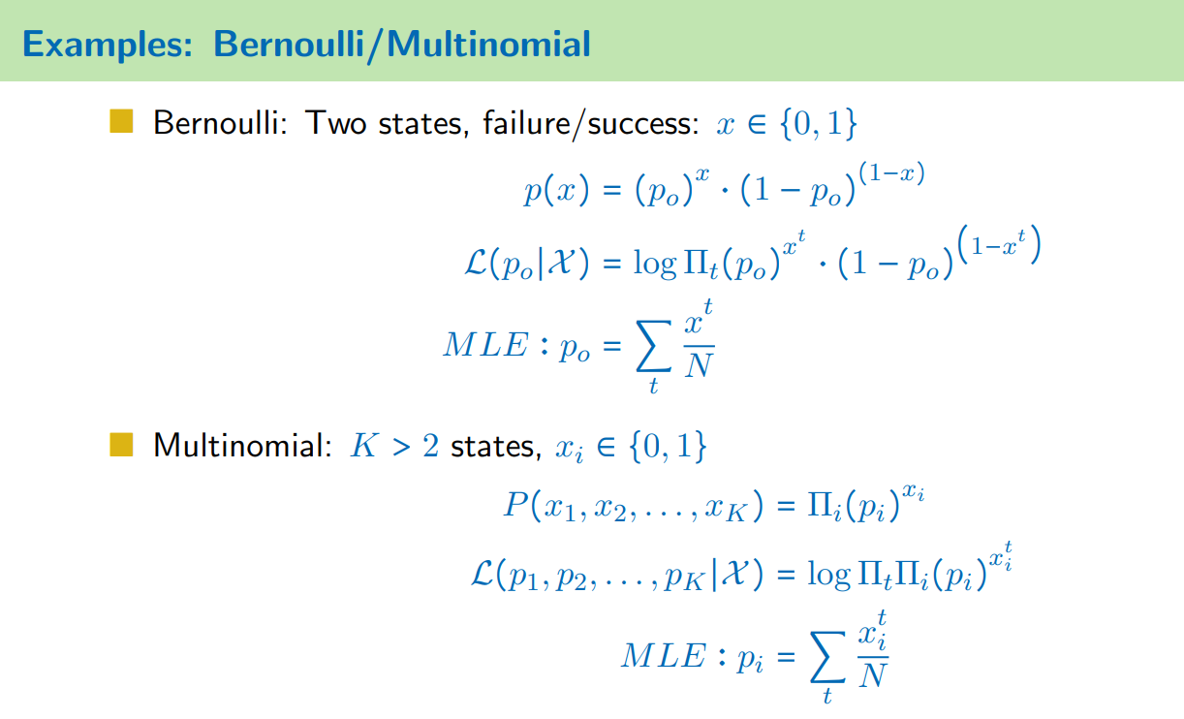
Parametric Estimation
Bayes’ Estimator
Parametric Classification
Parametric Regression
Bias/Variance Dilemma
Parametric Regression

Slide 14
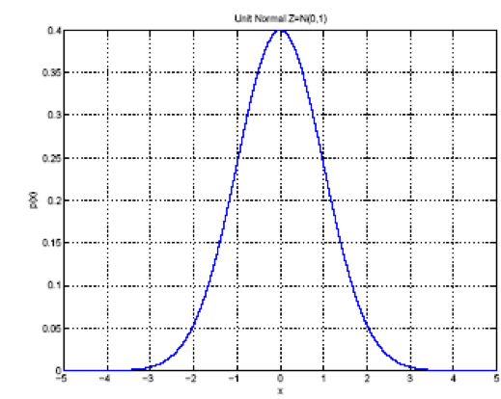
Parametric Estimation
Bayes’ Estimator
Parametric Classification
Parametric Regression
Bias/Variance Dilemma
Parametric Regression
Gaussian (Normal) Distribution
p(x) = N (µ, σ²)
p(x) =
1
– (x−µ)²
exp
√
2σ²
2πσ
MLE for µ and σ²:
∑ x
t
µ =
t
N
t
2
∑ (x − µ)
_{σ}2 ₌ t
N
CSE 405: Machine Learning

Slide 15
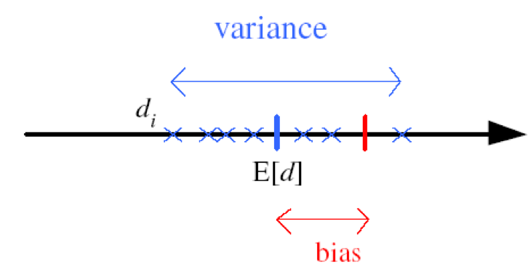
Parametric Estimation
Bayes’ Estimator
Parametric Classification
Parametric Regression
Bias/Variance Dilemma
Parametric Regression
Bias and Variance
Unknown parameter θ Estimator d_{i} = d(X_{i}) on sample X_{i}
Bias:
b_{θ} (d) = E[d] − θ
Variance: E[(d − E[d])²]
Bias refers to the difference between the expected value of an estimator (or a model’s predicted value) and the true value of the parameter or quantity being estimated.
CSE 405: Machine Learning

Slide 16
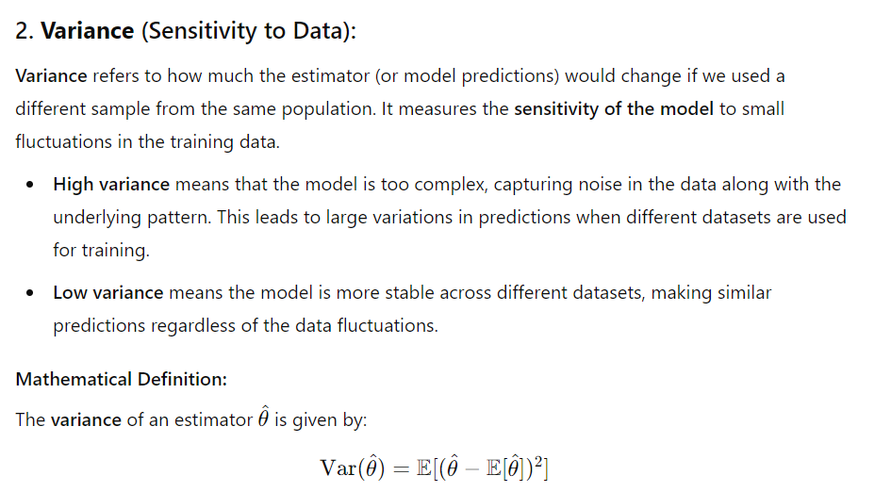
Parametric Estimation
Bayes’ Estimator
Parametric Classification
Parametric Regression
Bias/Variance Dilemma
Parametric Regression
CSE 405: Machine Learning

Slide 17
Parametric Estimation
Bayes’ Estimator
Parametric Classification
Parametric Regression
Bias/Variance Dilemma
Parametric Regression
Mean square error:
r(d, θ) = E[(d − θ)²]
= (E[d] − θ)² + E[(d − E[d])²]
= Bias² + Variance
CSE 405: Machine Learning

Slide 18
Parametric Estimation
Bayes’ Estimator
Parametric Classification
Parametric Regression
Bias/Variance Dilemma
Parametric Regression
Bayes’ Estimator
CSE 405: Machine Learning

Slide 19
Parametric Estimation
Bayes’ Estimator
Parametric Classification
Parametric Regression
Bias/Variance Dilemma
Parametric Regression
Bayes’ Estimator
The Bayes' estimator is a statistical estimation method that shows Bayesian probability theory to estimate an unknown parameter by incorporating prior information and observed data.
Unlike classical estimators like the maximum likelihood estimator (MLE), which only consider the data at hand, Bayes' estimators combine prior beliefs about the parameter with evidence from the data to make more informed decisions.
CSE 405: Machine Learning

Slide 20
Parametric Estimation
Bayes’ Estimator
Parametric Classification
Parametric Regression
Bias/Variance Dilemma
Parametric Regression
Bayes’ Estimator
Treat θ as a random variable with prior p(θ)
Bayes’ rule: p(θ∣X) =
p(X∣θ)p(θ) p(X)
Full: p(x∣X ) = ∫p(x∣θ)p(θ ∣ X ) d θ
Maximum a posteriori (MAP): θ_{MAP} = arg max_{θ} p(θ∣X )
Maximum Likelihood (ML): θ_{ML} = arg max_{θ} p(X ∣θ)
Bayes’: θ_{Bayes}′ = E[θ∣X ] = ∫ θ p(θ∣X )dθ
CSE 405: Machine Learning

Slide 21
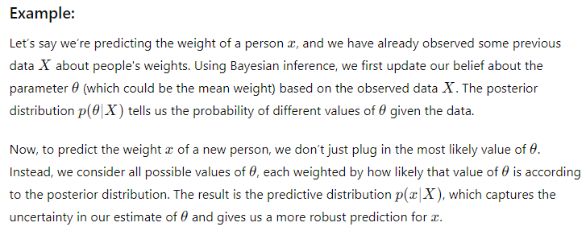
Parametric Estimation
Bayes’ Estimator
Parametric Classification
Parametric Regression
Bias/Variance Dilemma
Parametric Regression
FULL
Full: p(x∣X ) = ∫p(x∣θ)p(θ ∣ X ) d θ
CSE 405: Machine Learning

Slide 22
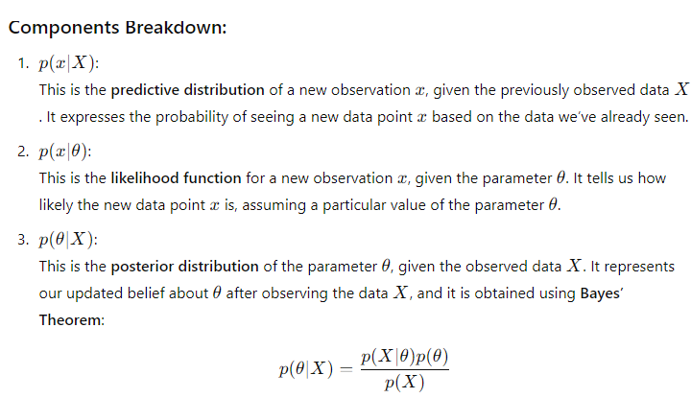
Parametric Estimation
Bayes’ Estimator
Parametric Classification
Parametric Regression
Bias/Variance Dilemma
Parametric Regression
FULL
Full: p(x∣X ) = ∫p(x∣θ)p(θ ∣ X ) d θ
CSE 405: Machine Learning

Slide 23
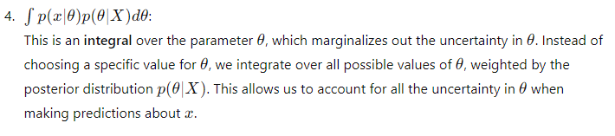
Parametric Estimation
Bayes’ Estimator
Parametric Classification
Parametric Regression
Bias/Variance Dilemma
Parametric Regression
FULL
Full: p(x∣X ) = ∫p(x∣θ)p(θ ∣ X ) d θ
CSE 405: Machine Learning

Slide 24
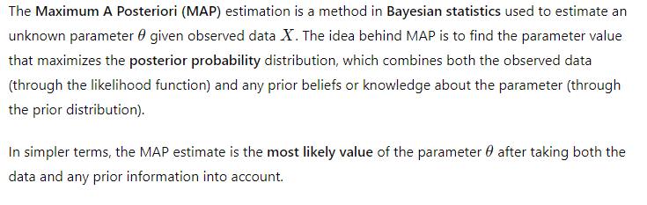
Parametric Estimation
Bayes’ Estimator
Parametric Classification
Parametric Regression
Bias/Variance Dilemma
Parametric Regression
MAP
Full: p(x∣X ) = ∫p(x∣θ)p(θ ∣ X ) d θ
CSE 405: Machine Learning

Slide 25
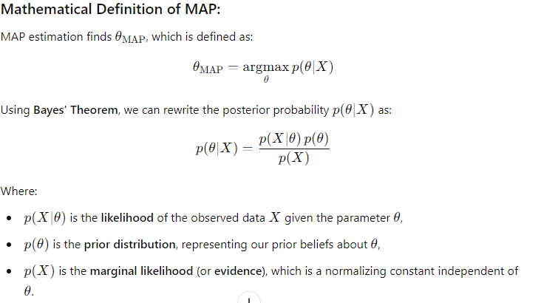
Parametric Estimation
Bayes’ Estimator
Parametric Classification
Parametric Regression
Bias/Variance Dilemma
Parametric Regression
MAP
CSE 405: Machine Learning

Slide 26
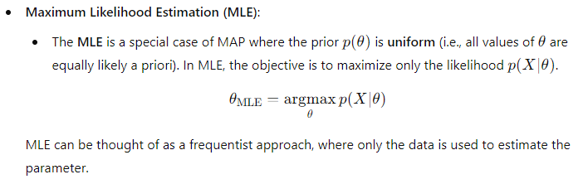
Parametric Estimation
Bayes’ Estimator
Parametric Classification
Parametric Regression
Bias/Variance Dilemma
Parametric Regression
MLE
CSE 405: Machine Learning

Slide 27
Parametric Estimation
Bayes’ Estimator
Parametric Classification
Parametric Regression
Bias/Variance Dilemma
Parametric Regression
Parametric Classification
CSE 405: Machine Learning

Slide 28
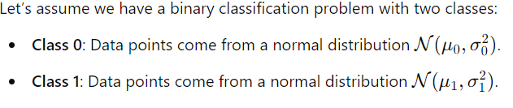
In parametric classification, the goal is to classify data points into one of several predefined classes based on a parametric model.

Slide 29

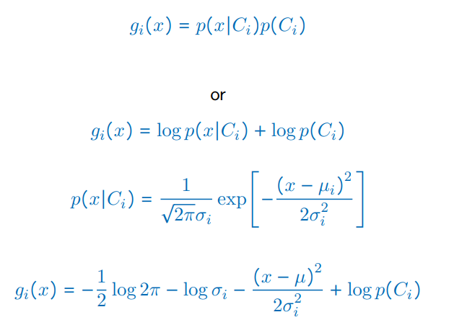
Parametric Estimation
Bayes’ Estimator
Parametric Classification
Parametric Regression
Bias/Variance Dilemma
Parametric Regression
Parametric Classification

Slide 30
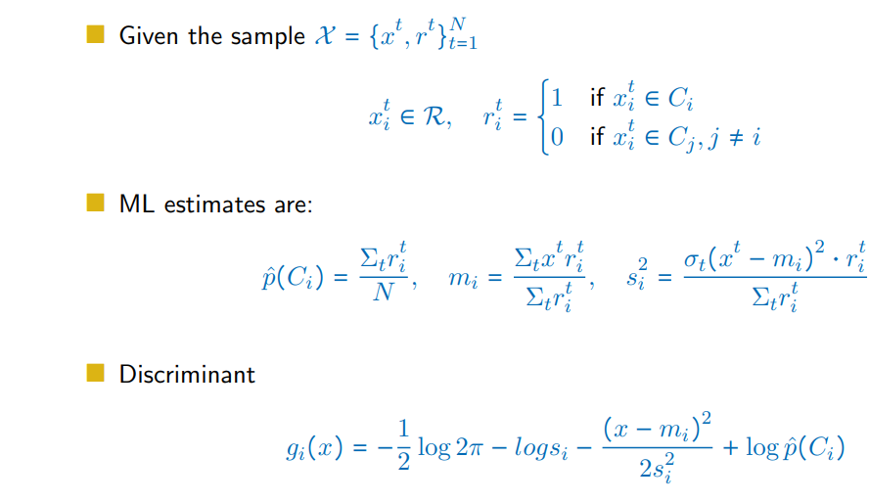
Parametric Estimation
Bayes’ Estimator
Parametric Classification
Parametric Regression
Bias/Variance Dilemma
Parametric Regression

Slide 31
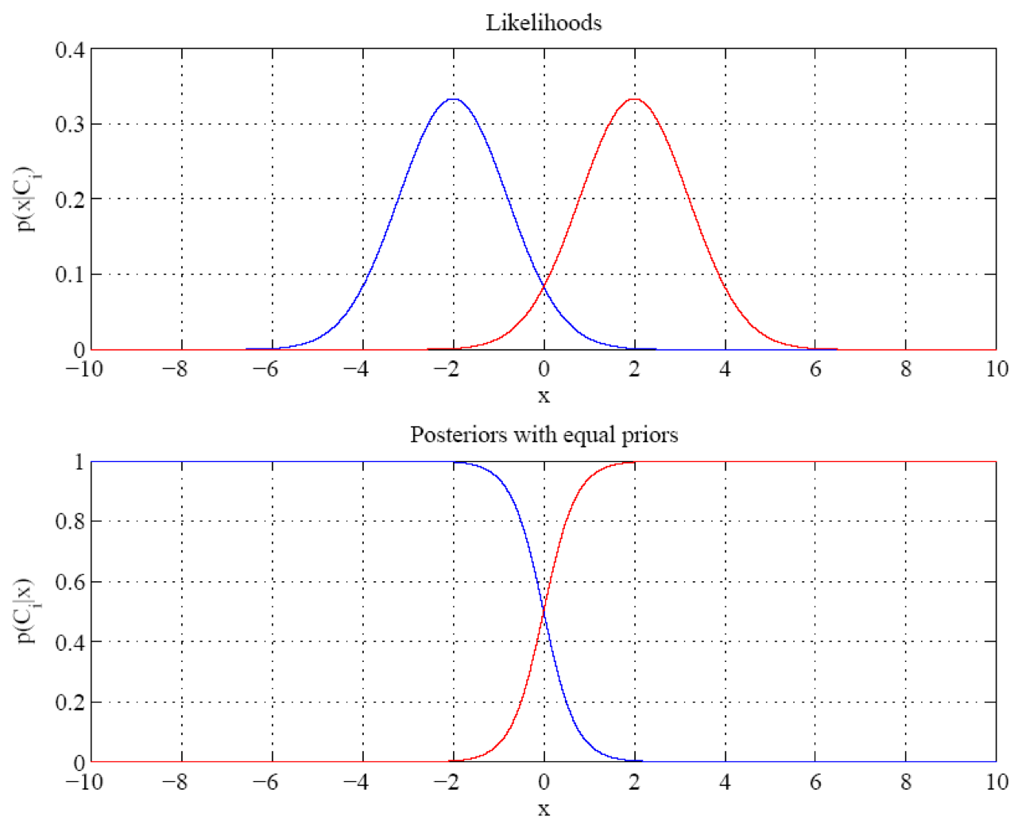
Parametric Estimation
Bayes’ Estimator
Parametric Classification
Parametric Regression
Bias/Variance Dilemma
Parametric Regression
CSE 405: Machine Learning

Slide 32
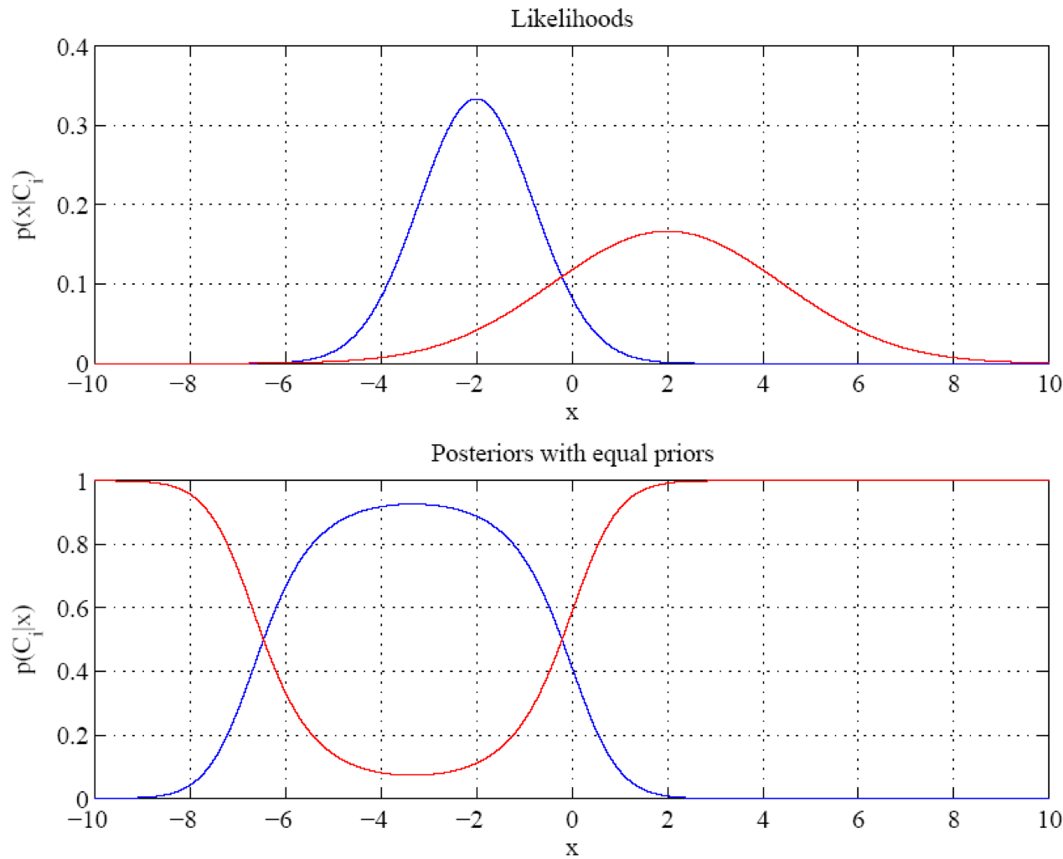
Parametric Estimation
Bayes’ Estimator
Parametric Classification
Parametric Regression
Bias/Variance Dilemma
Parametric Regression
CSE 405: Machine Learning

Slide 33
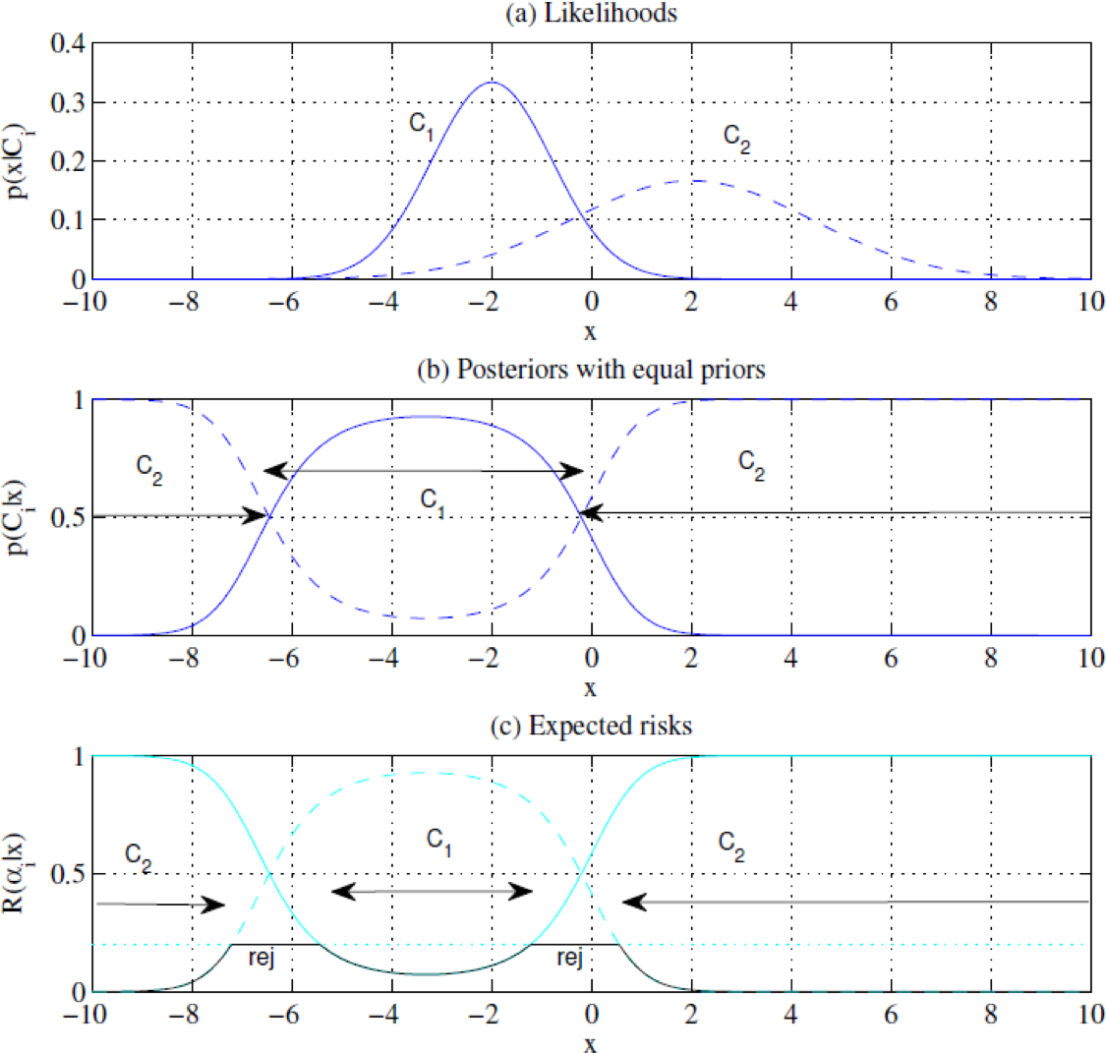
Parametric Estimation
Bayes’ Estimator
Parametric Classification
Parametric Regression
Bias/Variance Dilemma
Parametric Regression
CSE 405: Machine Learning

Slide 34
Parametric Estimation
Bayes’ Estimator
Parametric Classification
Parametric Regression
Bias/Variance Dilemma
Parametric Regression
Parametric Regression
CSE 405: Machine Learning

Slide 35
Parametric regression is a type of regression analysis where we assume that the relationship between the independent variables (predictors) and the dependent variable (target) can be modeled by a specific functional form, typically characterized by a finite set of parameters.

Slide 36
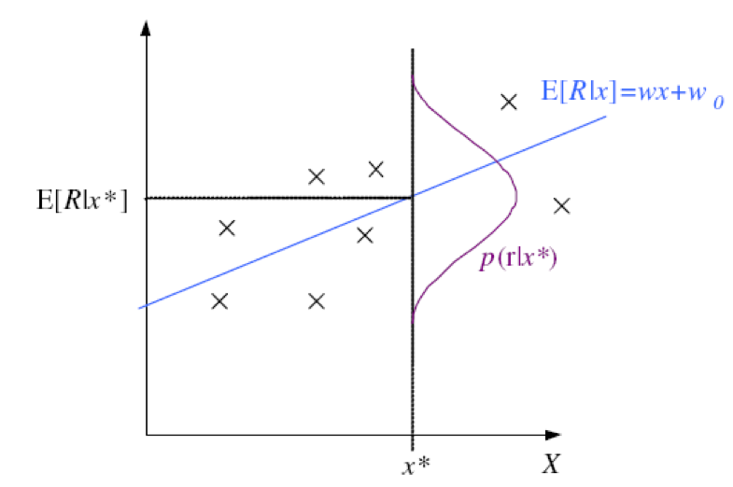
Parametric Estimation
Bayes’ Estimator
Parametric Classification
Parametric Regression
Bias/Variance Dilemma
Parametric Regression
Regression
r = f (x) + ϵ
estimator g(x∣θ)
ϵ ∼ N (0, σ²)
p(r∣x) ∼ N (g(x∣θ), σ²)
N t t
L(θ∣X ) = log Π p(
x , r )
t=1
N t t
N
t
= log Π p(
r ∣x ) + log Π p(
x )
t=1
t=1
CSE 405: Machine Learning

Slide 37
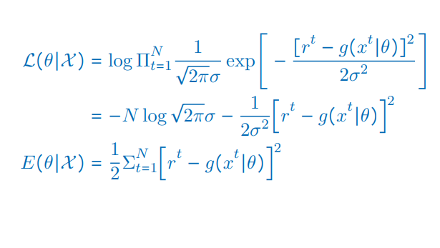
Parametric Estimation
Bayes’ Estimator
Parametric Classification
Parametric Regression
Bias/Variance Dilemma
Parametric Regression
Regression: From log L to Error
CSE 405: Machine Learning

Slide 38
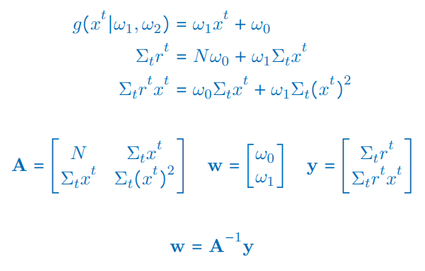
Parametric Estimation
Bayes’ Estimator
Parametric Classification
Parametric Regression
Bias/Variance Dilemma
Parametric Regression
Linear Regression
CSE 405: Machine Learning

Slide 39
Parametric Estimation
Bayes’ Estimator
Parametric Classification
Parametric Regression
Bias/Variance Dilemma
Parametric Regression
Polynomial Regression
g(x^{t}∣ω_{k}, . . . , ω₂, ω₁, ω₀) = ω_{k} (x^{t})^{k} + ⋯ + ω₂(x^{t})² + ω₁x^{t} + ω₀
_{x}2
2
D = ^{x}
⎢⋮ ⋮
_{x}N
⎡_{⎢1}
(x¹)² ⋯ (x¹)^{k ⎤}⎥
⎡_{⎢ r}¹ ⎤⎥
⎢1
2 2
2 k
(x )
⋯ (x )
⎥
⎢ ^{r2} ⎥
r =
⋮
⋱ ⋮
⋮
⎥
⎢ ⎥
⎢ ⎥
⎢_{⎣1}
N k
⎥
r
N
(x^{N} )² ⋯ (x )
⎦
⎣ ⎦
w = (D^{T} D)⁻¹D^{T} r
CSE 405: Machine Learning

Slide 40
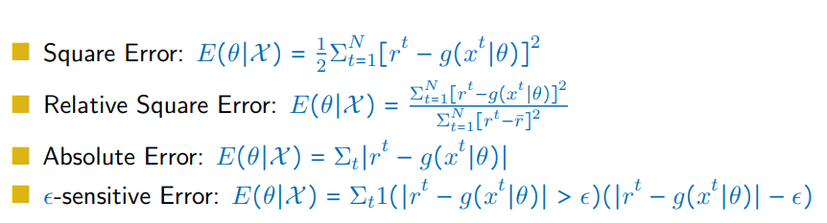
Parametric Estimation
Bayes’ Estimator
Parametric Classification
Parametric Regression
Bias/Variance Dilemma
Parametric Regression
Other Error Measures
CSE 405: Machine Learning

Slide 41
Parametric Estimation
Bayes’ Estimator
Parametric Classification
Parametric Regression
Bias/Variance Dilemma
Parametric Regression
Bias and Variance
E⌊(r − g(x))²∣x⌋ = E⌊(r − E[r∣c])²∣x⌋ + (E[r∣x] − g(x))²
E_{x}⌊(E[r∣x] − g(x))²∣x⌋ = (E[r∣x] − E_{x}[g(x)])² + E_{x}⌊(g(x) − E_{x}[g(x)])²⌋
CSE 405: Machine Learning

Slide 42
Parametric Estimation
Bayes’ Estimator
Parametric Classification
Parametric Regression
Bias/Variance Dilemma
Parametric Regression
Estimating Bias and Variance
t t
M samples X = {x , r }
, i = 1, . . . , M are used to fit g (
x), i = 1, . . . , M
i i i
i
1
Bias²(g) = Σ_{t}[g¯(x^{t}) − f (x^{t})]²
1
1
t
t 2
Variance(g) = Σ Σ [
g (x ) − (
g¯(x )]
MN
t i i
1
(g¯)(x) = Σ g (
x)
M
t i
CSE 405: Machine Learning

Slide 43
Parametric Estimation
Bayes’ Estimator
Parametric Classification
Parametric Regression
Bias/Variance Dilemma
Parametric Regression
Bias/Variance Dilemma
CSE 405: Machine Learning

Slide 44
Parametric Estimation
Bayes’ Estimator
Parametric Classification
Parametric Regression
Bias/Variance Dilemma
Parametric Regression
Bias/Variance Dilemma
Example: g (
x) = 2 has no variance and high bias g (
t
i
i
x) = Σ r /
N has lower bias
t i
with variance
As we increase complexity, bias decreases (a better fit to data) and variance increases (fit varies more with data)
Bias/Variance dilemma: (Geman et al., 1992)
CSE 405: Machine Learning

Slide 45
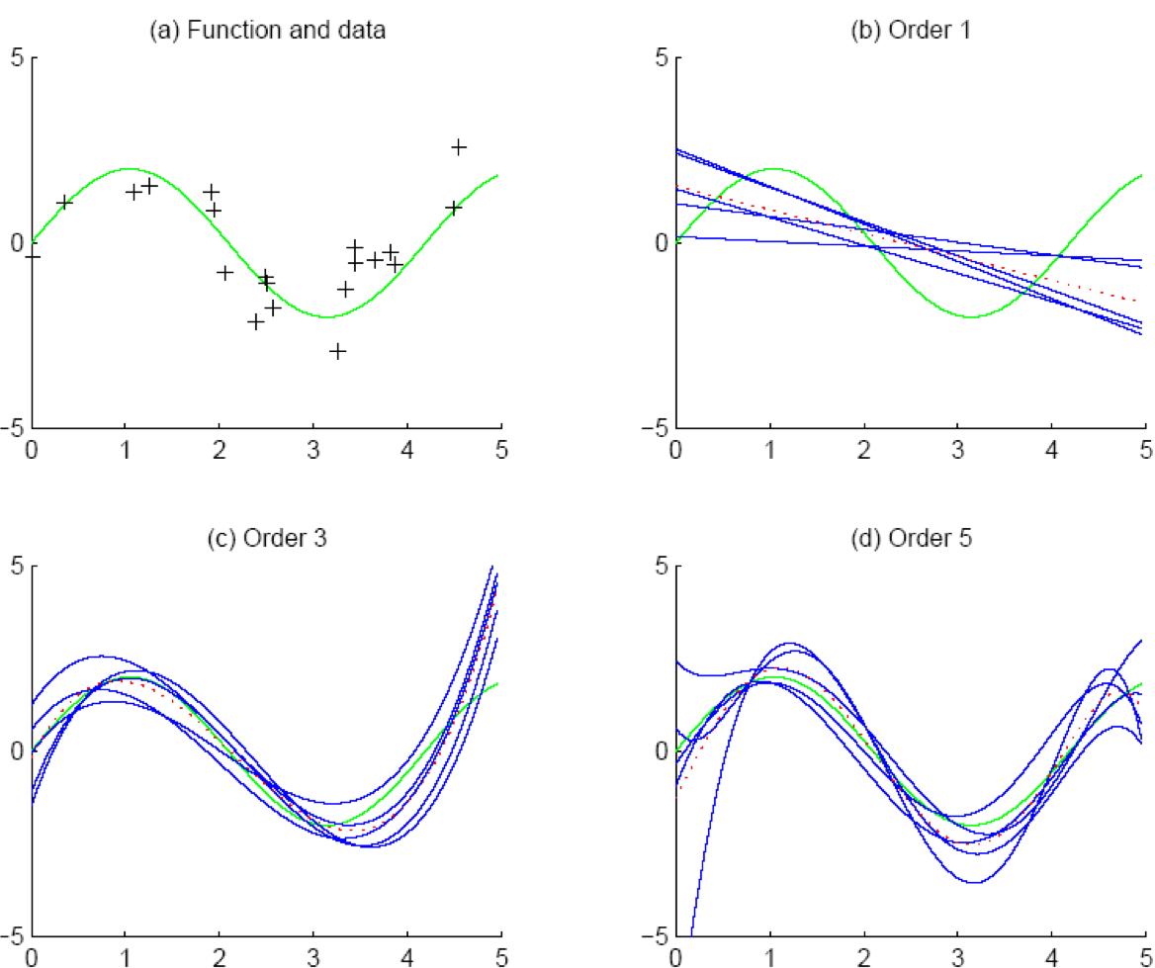
Parametric Estimation
Bayes’ Estimator
Parametric Classification
Parametric Regression
Bias/Variance Dilemma
Parametric Regression
CSE 405: Machine Learning

Slide 46
Parametric Estimation
Bayes’ Estimator
Parametric Classification
Parametric Regression
Bias/Variance Dilemma
Parametric Regression
Polynomial Regression
CSE 405: Machine Learning

Slide 47
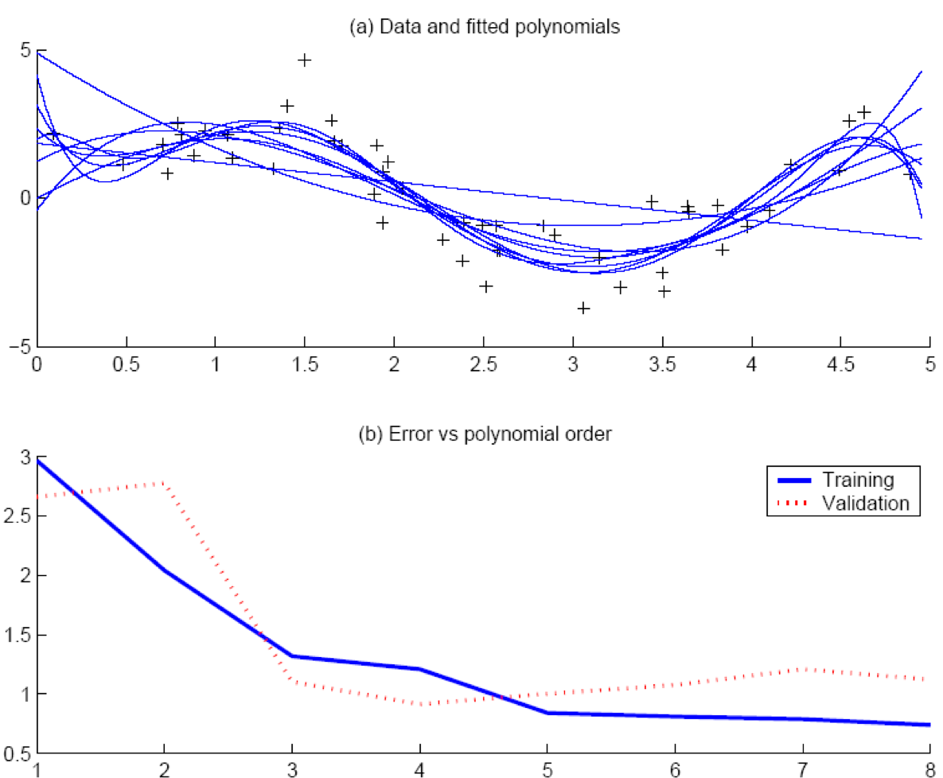
Parametric Estimation
Bayes’ Estimator
Parametric Classification
Parametric Regression
Bias/Variance Dilemma
Parametric Regression
CSE 405: Machine Learning

Slide 48
Parametric Estimation
Bayes’ Estimator
Parametric Classification
Parametric Regression
Bias/Variance Dilemma
Parametric Regression
Model Selection
CSE 405: Machine Learning

Slide 49
Parametric Estimation
Bayes’ Estimator
Parametric Classification
Parametric Regression
Bias/Variance Dilemma
Parametric Regression
Model Selection
Cross-validation: Measure generalization accuracy by testing on data unused during training
Regularization: Penalize complex models
E′ = error on data + λ model complexity
Akaike’s information criterion (AIC), Bayesian information criterion (BIC)
Minimum description length (MDL): Kolmogorov complexity, shortest description of data
Structural risk minimization (SRM)
CSE 405: Machine Learning

Slide 50
Parametric Estimation
Bayes’ Estimator
Parametric Classification
Parametric Regression
Bias/Variance Dilemma
Parametric Regression
Bayesian Model Selection
Prior on models, p(model)
p(data∣model)p(model)
p(model
∣data) =
p(data)
Regularization, when prior favors simpler models
Bayes, MAP of the posterior, p(model∣data)
Average over a number of models with high posterior (voting, ensembles: Chapter 17)
CSE 405: Machine Learning

Slide 51
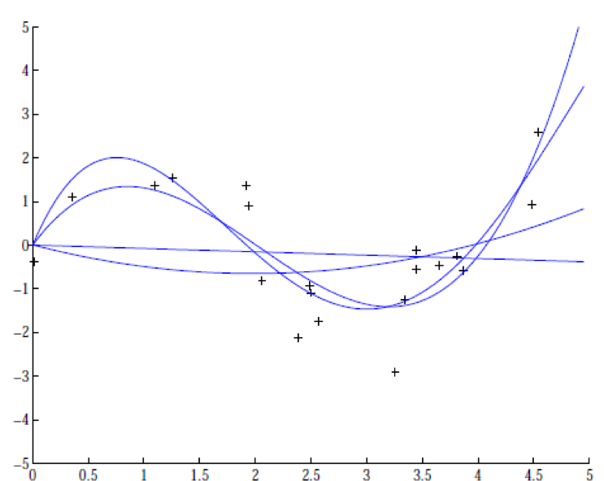
Parametric Estimation
Bayes’ Estimator
Parametric Classification
Parametric Regression
Bias/Variance Dilemma
Parametric Regression
Regression example
CSE 405: Machine Learning

Slide 52
Thank You!

